Slide 1
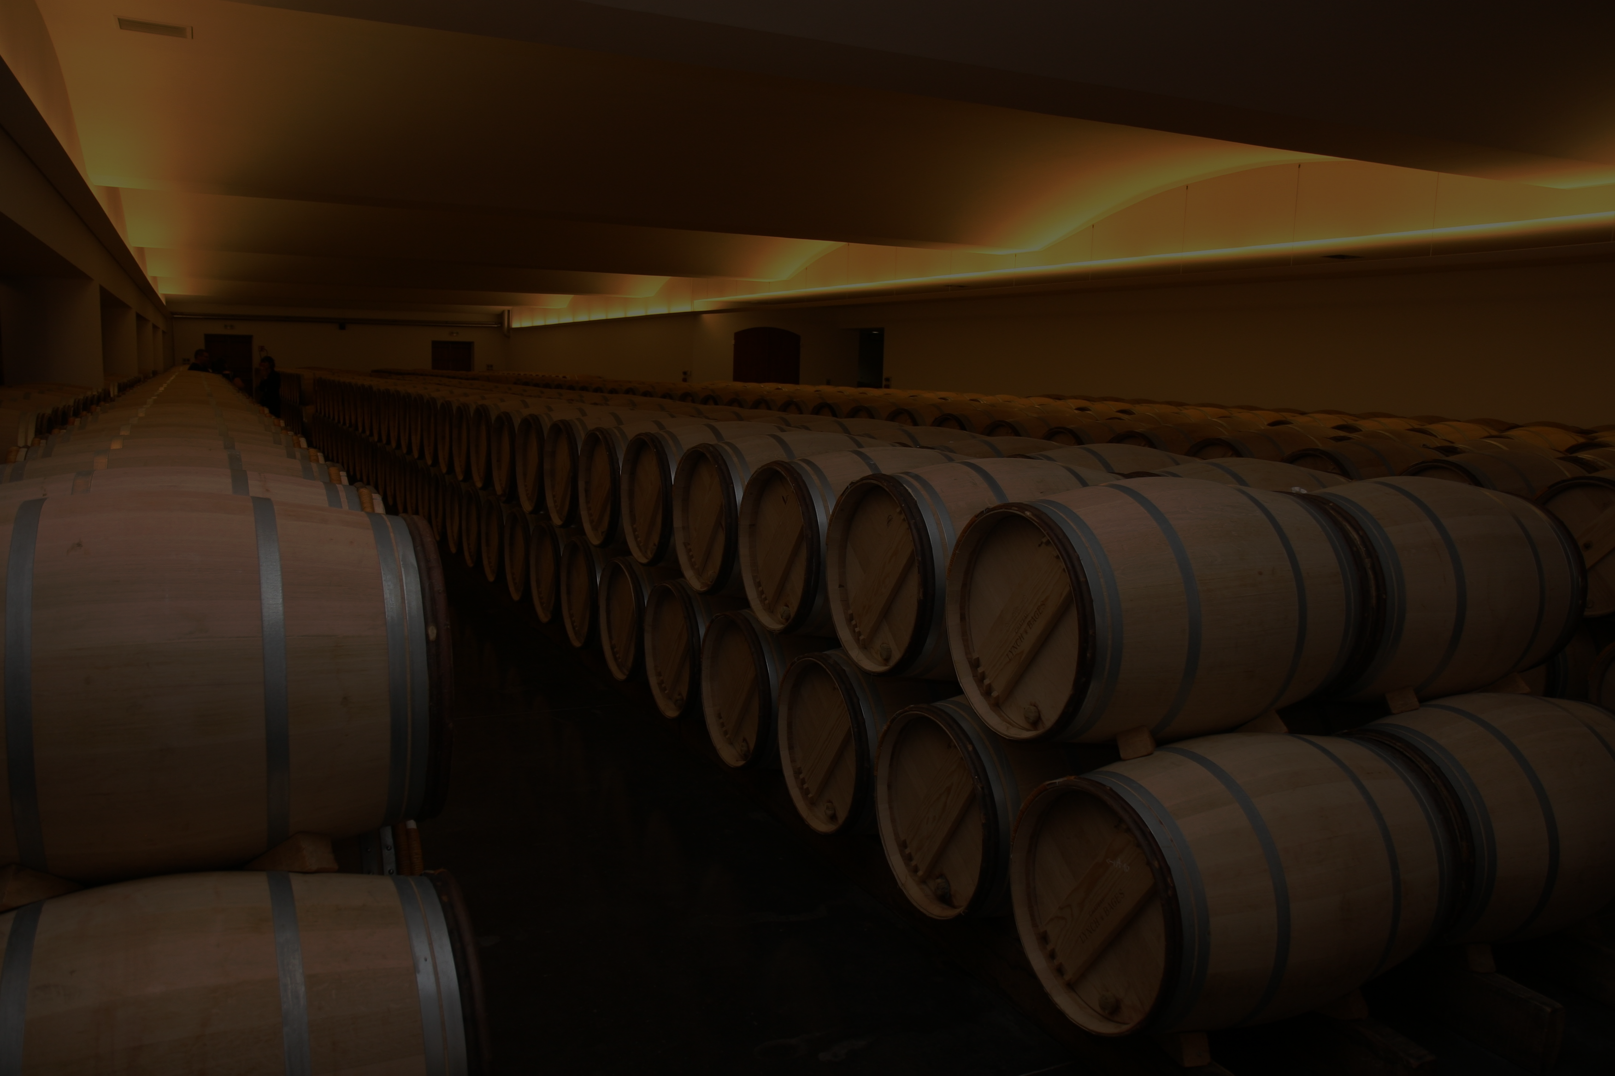
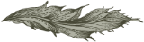
Wine Quality
Arman Azhand & Eric Graham
DDS DS 6306 Project 2

Slide 2

Who are we? Data Scientists with DDS
What will we accomplish? Two Objectives
Objective A
Build a predictive model that will predict a wine’s quality based off of its physicochemical features
Objective B
Uncover key factors that contribute to high-quality wine
This Photo by Unknown Author is licensed under CC BY-NC-ND

Slide 3
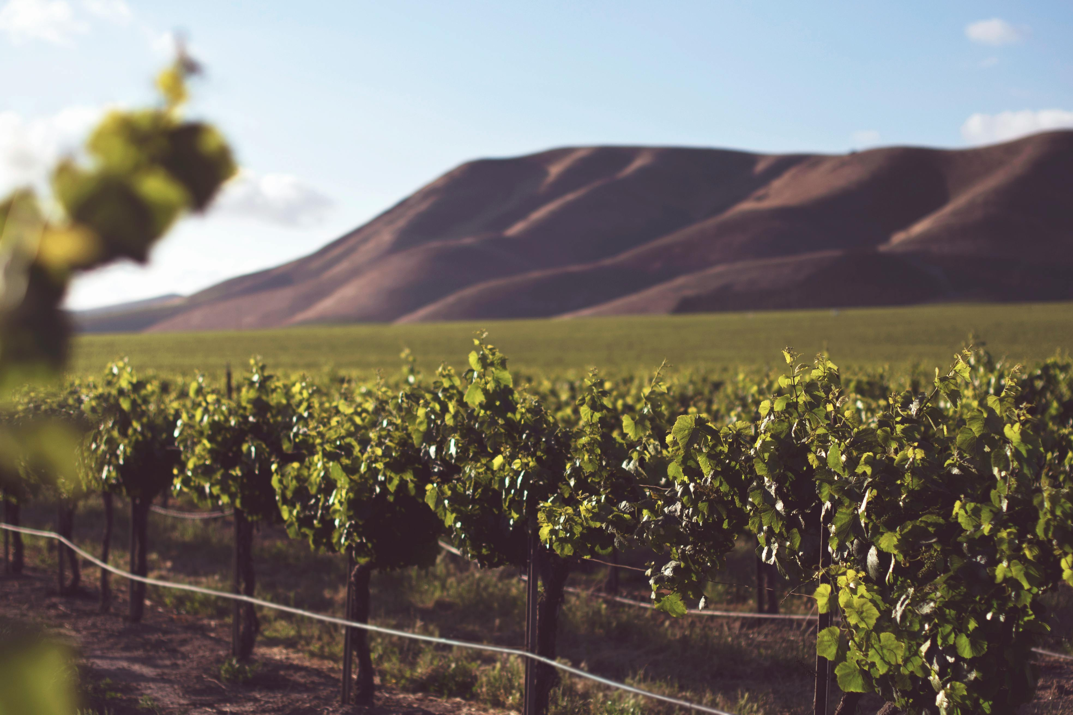
What is our data?
15 Variables:
1 Identifier, 13 Physicochemical Variables (Explanatory), & Quality (score)
Two data sets (totaling 6497 observations):
Training (5463 observations) & Testing (1034 observations). Location and Type were stored separately
Some errors or missing data in the dataset:
Location’s misspelled, missing type on some observations (imputed for with 94.46% accuracy)

Slide 4

Two Objectives
Objective A Build a predictive model that will predict a wine’s quality based off of its physicochemical features
Objective B Uncover key factors that contribute to high-quality wine

Slide 5
Objective B How will we fulfill our objective?
Look at:
Linear relationships between quality and other features (correlations)
Observe other patterns within the features (potential non-linear relationships?)
Look at physicochemical features in context of type and location

Slide 6
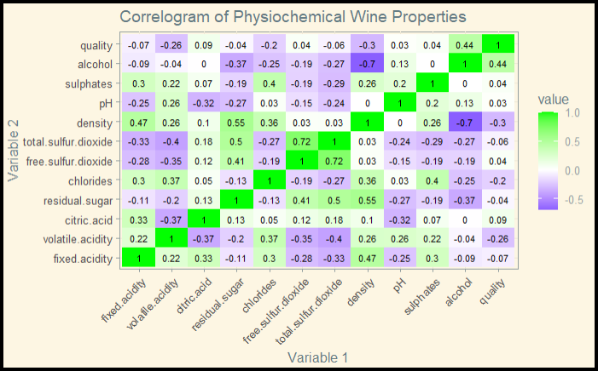
Linear Relationships (Correlations) Quality versus numeric physicochemical features
Quality and Alcohol (0.44)
Quality and Density (-0.3)
Quality and Volatile Acidity (-0.26)
None are very strong linear relationships
Interesting to note that density and alcohol seem to be fairly negatively correlated (-0.7)
Values closer to 1 (negative or positive) mean a stronger linear relationship, while values closer to 0 mean a weak or non-existent linear relationship
Positive values mean as one value increases, so does the other
Negative values mean as one value increases, the other decreases

Slide 7
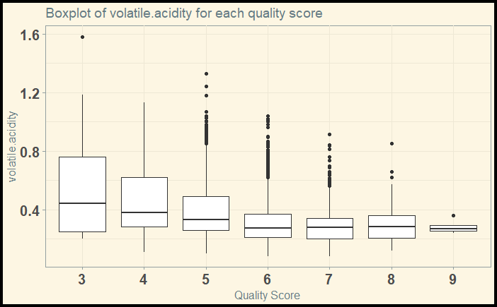
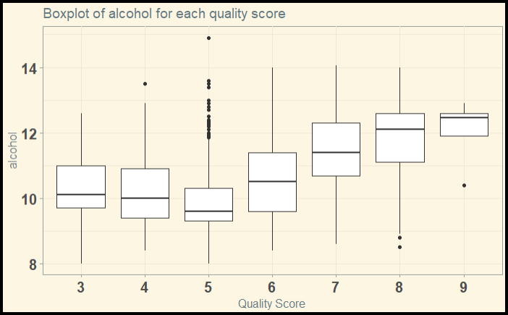
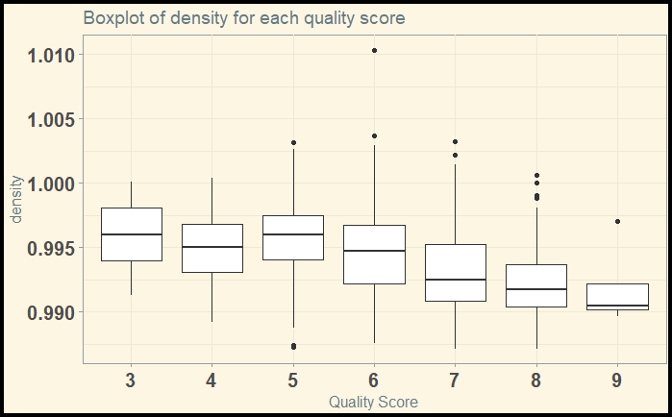
Potential Non-linear Relationships Potential non-linear relationships with quality
Alcohol:
Slight non-linear trend in medians
Density:
Slight non-linear trend in medians
Volatile Acidity:
Variance in value gets smaller as quality improves

Slide 8
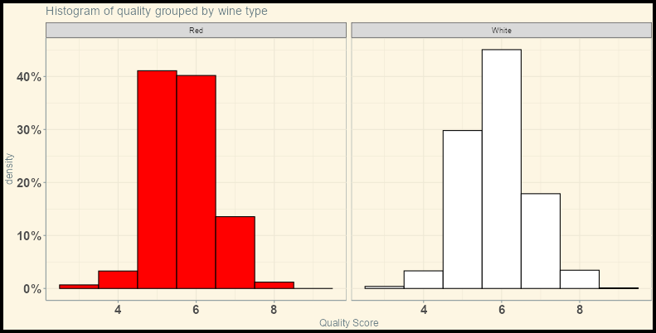
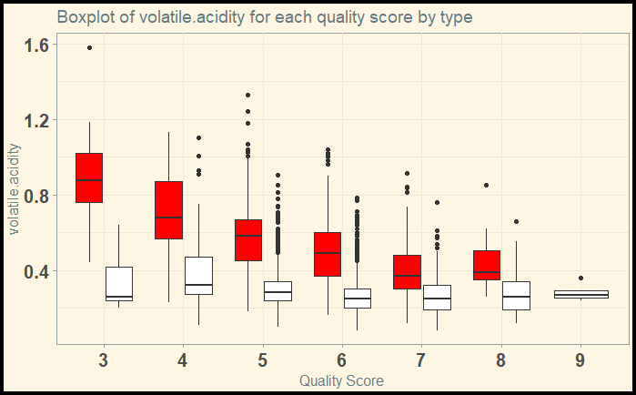
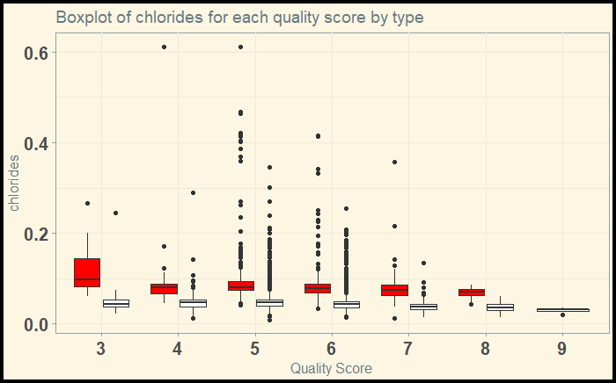
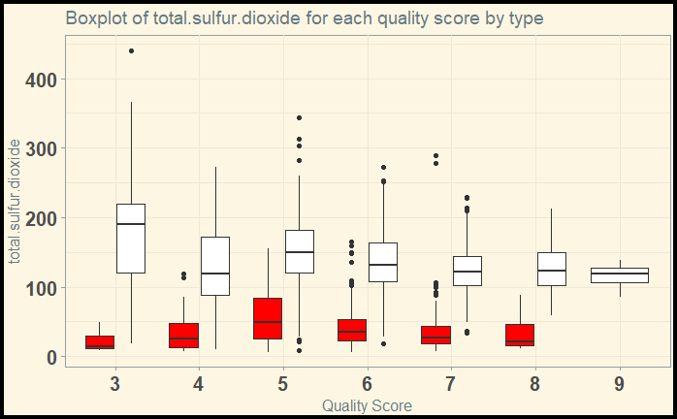
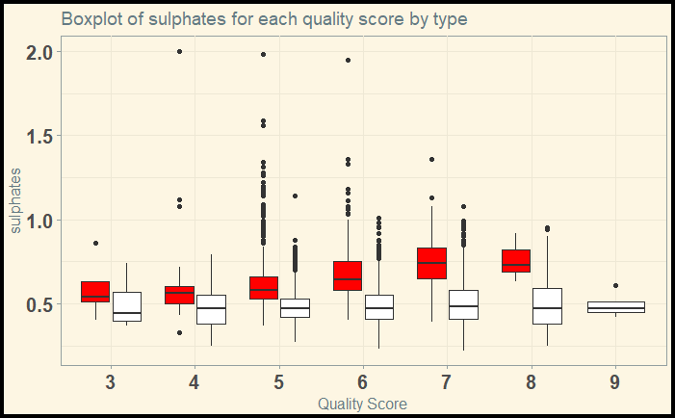
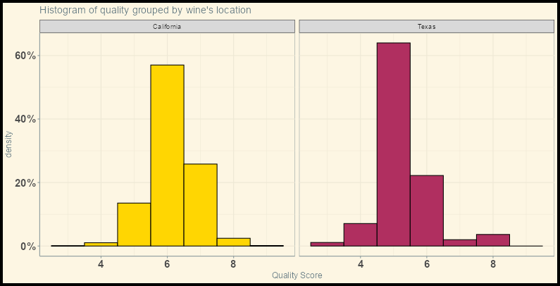
Looking at features in context of groups Grouped by Type (Red and White) & Location (California and Texas)
Red wine scores slightly lower on average
California has scores slightly higher on average
Chlorides are fairly constant for both, but on average are higher for Red wine
Total Sulfur Dioxide are fairly constant for both, but on average are higher for White wine
Volatile Acidity is fairly constant for White, but decreases for Red as quality improves
Sulphates are fairly constant for White, but increase for Red as quality improves
Location interactions with features were not interesting at a glance (fairly similar results within both groups)

Slide 9
Top Features
Alcohol & Density
Appear to have fairly clear correlation with quality (slightly non-linear)
Grouping by Type
Chlorides are fairly constant for both, but on average are higher for Red wine
Total Sulfur Dioxide are fairly constant for both, but on average are higher for White wine
Volatile Acidity is fairly constant for White, but decreases for Red as quality improves
Sulphates are fairly constant for White, but increase for Red as quality improves
Alcohol + Density - and if differentiating by type (of wine) Volatile Acidity Chlorides Sulphates Total Sulfur Dioxide

Slide 10
Objective A How will we fulfill our objective?
We will:
Choose important features
Build multiple models
Multiple Linear Regression (MLR)
Naïve-Bayes (NB)
K-Nearest Neighbors (KNN)
Calculate Mean Absolute Error
Compare models and choose the one with the lowest MAE

Slide 11
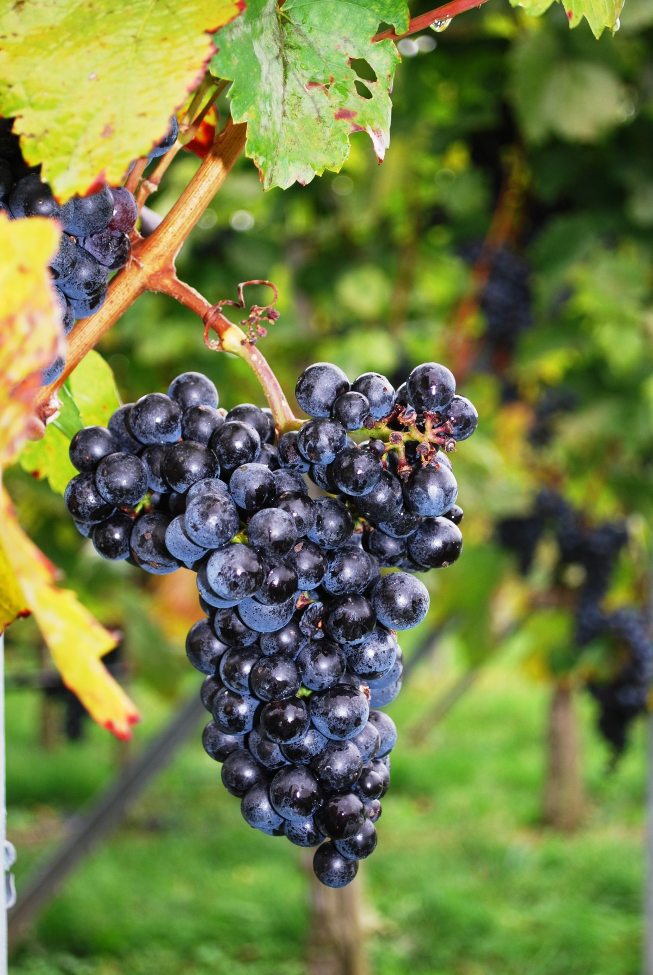
Feature selection
Built models using:
Top features from Objective B (when applicable)
All variables (when applicable)
Transform data (when applicable)

Slide 12
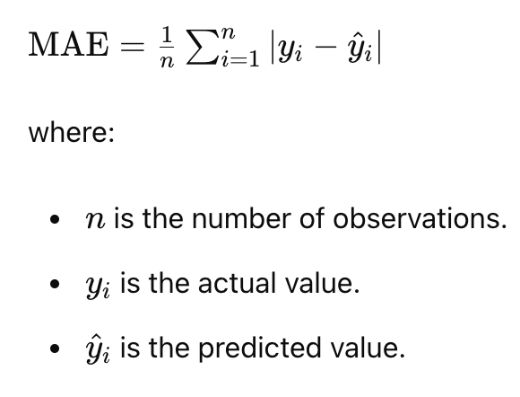
Model Selection Looking at the Mean Absolute Error
MODEL | MAE
Multiple Linear Regression (with top features) | 0.5163829
Multiple Linear Regression (with top features and linear-log transformation) | 0.5216914
Multiple Linear Regression (with stepwise feature selection) | 0.4371225
Naïve-Bayes (with all features) | 0.5573861
Naïve-Bayes (with top features) | 0.6252975
K-Nearest Neighbors (with all continuous features, tuned k = 16) | 0.7882855
K-Nearest Neighbors (with top continuous features, tuned k = 9) | 0.5851129

Slide 13
What to do next? Future wine quality prediction and improvements
Collect more data
Retrain models in the future with additional data
If changes were made to wine production, track changes to see if quality improves
Explore other models
Wider arsenal of predictive models exist and may be more appropriate
Feature selection can be improved with deeper analysis

Slide 14

Thank you
Arman Azhand Eric Graham
aazhand@mail.smu.edu egraham@mail.smu.edu

